Slide 1
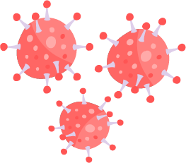



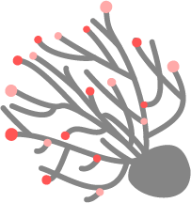
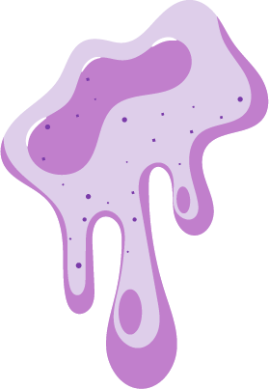


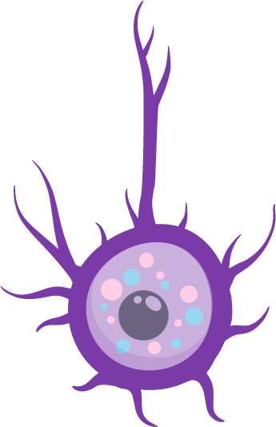
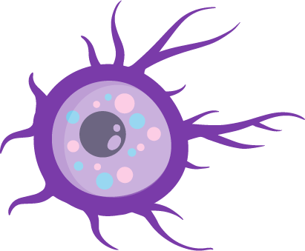
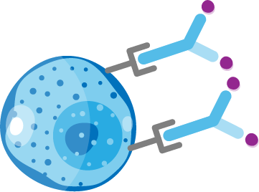
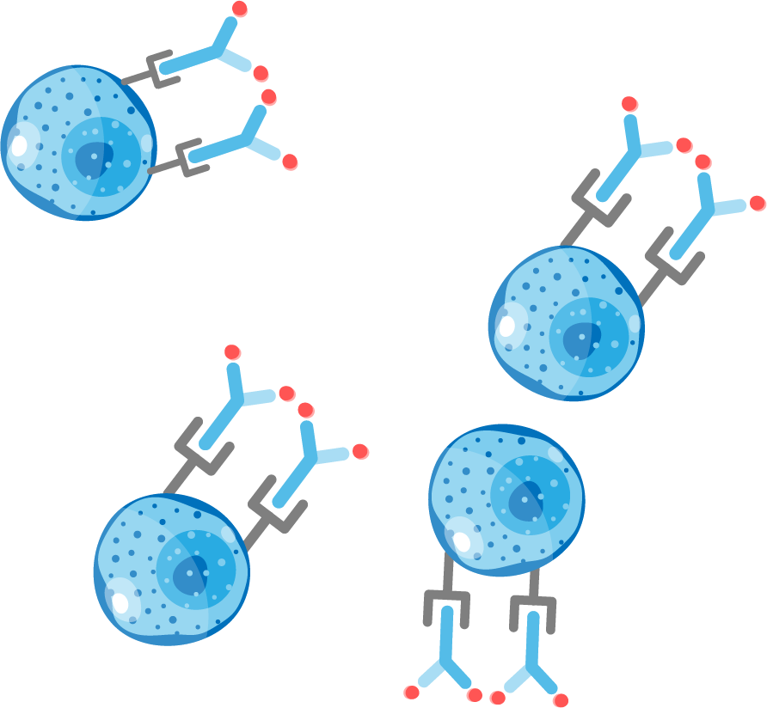



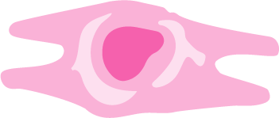
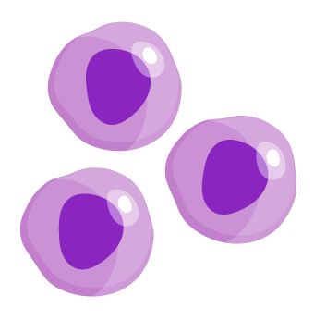
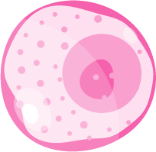




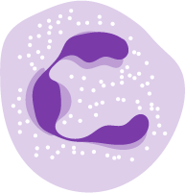
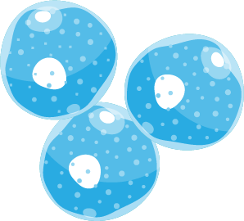
Similar inflammatory processes are associated with both upper and lower airway diseases^{1–3}
Inflammation in upper airways disease
Inflammation in asthma
Triggers
Viruses
Bacteria
Allergens
Cytokines
Fungi
Mucus
Smoke
Pollution
Epithelium
IL-5
IL-13
TSLP
IL-33
TSLP
IL-33
IL-25
TSLP
IL-33
IL-25
TSLP
Goblet cell
Dendritic cell
Collagen
IL-18
Dendritic cell
Dendritic cell
Mast cells
Basophil
Naïve
T cell
IL-12
TSLP
IL-13
IL-13
IL-18
ILC3s
IL-17
IL-22
Histamine
Leukotrienes
IL-5
IL-5
TSLP
Fibroblast
IgE
IL-4, IL-13
Th2
cells
ILC2s
ILC1s
IFN-γ
TNF-α
IL-4, IL-13
Mast cells
Th1 cell
Th17 cell
NK
B cells
IL-13
Eosinophils
TSLP
IL-6
IL-13
IL-13
Neutrophil
Macrophage
Smooth muscle
Type 1
Type 2
Beyond Type 2
Type 3

Slide 2
Similar inflammatory cascades are implicated in CRSwNP, CRSsNP,
AR and NARES^{1–10}
CRSwNP
CRSsNP
Allergic rhinitis
CRSwNP
CRSsNP
CRSwNP
CRSsNP
NARES
Triggers
Viruses
Bacteria
Allergens
Cytokines
Fungi
Mucus
Pollution
Epithelium
IL-5
IL-13
TSLP
IL-33
TSLP
IL-33
IL-25
TSLP
IL-33
IL-25
TSLP
Goblet cell
Dendritic cell
Collagen
IL-18
Dendritic cell
Dendritic cell
Mast cells
Basophil
Naïve
T cell
IL-12
TSLP
IL-13
IL-13
IL-18
ILC3s
IL-17
IL-22
Histamine
Leukotrienes
IL-5
IL-5
TSLP
Fibroblast
IgE
IL-4, IL-13
Th2
cells
ILC2s
ILC1s
IFN-γ
TNF-α
IL-4, IL-13
Mast cells
Th1 cell
Th17 cell
NK
B cells
IL-13
Eosinophils
TSLP
IL-6
IL-13
IL-13
Neutrophil
Macrophage
Smooth muscle
Type 1
Type 2
Beyond Type 2
Type 3
Notes:
See subsequent slides for further elucidation of the inflammatory pathways involved in CRSwNP, CRSsNP, AR and NARES

Slide 3

CRSwNP is most commonly associated with T2 inflammation^{1–5}
Triggers
Bacteria
Viruses
Pollution
Epithelium
TSLP
IL-33
TSLP
IL-33
IL-25
TSLP
IL-33
IL-25
IL-5
IL-13
Dendritic cell
Mast cells
Basophil
Naïve
T cell
TSLP
IL-13
IL-13
Histamine
Leukotrienes
IL-4, IL-13
Th2
cells
IL-5
IL-5
IgE
ILC2s
IL-4, IL-13
B cells
Eosinophils
IL-13
IL-13
IL-13
Smooth muscle
CRSwNP can present with a T1, T2, T3, mixed or unidentifiable endotype.¹ Prevalence of the different endotypes appears to vary geographically, and in 80% of Caucasian cases, CRSwNP is associated with a T2 signature.² In patients with a T2 endotype, triggers such as bacteria, viruses and pollution interact with the epithelium causing the release of TSLP and IL-33 leading to the production of IL-4, IL-5 and IL-13 through the activation of ILC2s and mast cells^{1,2,5}
Figure adapted from Caminati M, et al. Allergy 2023;doi 10.1111/all.15986: Dec 26 [Epub ahead of print]
CRSwNP, chronic rhinosinusitis with nasal polyps; IgE, immunoglobulin E; IL, interleukin; ILC2, Type 2 innate lymphoid cell; T1, Type 1; T2, Type 2; T3, Type 3; Th, T helper; TSLP, thymic stromal lymphopoietin
1. Staudacher AG, et al. Ann Allergy Asthma Immunol 2020;124:318–325; 2. Laidlaw TM, et al. J Allergy Clin Immunol Pract 2021;9:1133–1141; 3. Stevens WW, et al. J Allergy Clin Immunol Pract 2016;4:565–572;
4. Kortekaas Krohn I, et al. Allergy 2018;73:837–850; 5. Fokkens WJ, et al. Rhinology 2020;58(Suppl. S29):1–464

Slide 4
CRSsNP has historically been characterised by T1 inflammation but is now considered to include a range of endotypes^{1–4}
Triggers
Bacteria
Viruses
Pollution
Epithelium
Dendritic cell
IL-12
IL-18
ILC1s
IFN-γ
TNF-α
CRSsNP was historically characterised by T1 inflammation, but there is now evidence that T2 inflammation may be the predominant endotype albeit with lower levels of T2 cytokines and eosinophils compared with CRSwNP.^{1,3} Common triggers of CRSsNP include bacteria, viruses and pollution,⁴ and in those patients with a T1 endotype, dendritic cells produce IL-12 and IL-18 which act on ILC1s to release IFN-γ and TNF-α most often in response to pathogens⁴
CRSsNP, chronic rhinosinusitis without nasal polyps; CRSwNP, chronic rhinosinusitis with nasal polyps; IFN, interferon; IL, interleukin; ILC1, Type 1 innate lymphoid cell; T1, Type 1; T2, Type 2; TNF, tumour necrosis factor
1. Staudacher AG, et al. Ann Allergy Asthma Immunol 2020;124:318–325; 2. Wang X, et al. J Allergy Clin Immunol 2016;138:1344–1353; 3. Cho SH, et al. J Allergy Clin Immunol Pract 2016;4:575–582; 4. Fokkens WJ, et al. Rhinology 2020;58(Suppl. S29):1–464

Slide 5
Allergic rhinitis is an IgE-mediated response to inhaled allergens characterised by T2 inflammation^{1–4}
Triggers
Allergens
Epithelium
TSLP
IL-33
TSLP
IL-33
IL-25
TSLP
IL-33
IL-25
IL-5
IL-13
Dendritic cell
Mast cells
Basophil
Naïve
T cell
TSLP
IL-13
IL-13
Histamine
Leukotrienes
IL-4, IL-13
Th2
cells
IL-5
IL-5
IgE
ILC2s
IL-4, IL-13
B cells
Eosinophils
IL-13
IL-13
IL-13
Smooth muscle
In patients with allergic rhinitis TSLP, IL-33 and IL-25 are released following allergen exposure, leading to T2 inflammation through the cytokines IL-4, IL-5 and IL-13^{2,3,5}
Figure adapted from Caminati M, et al. Allergy 2023;doi 10.1111/all.15986: Dec 26 [Epub ahead of print]
IgE, immunoglobulin E; IL, interleukin; ILC2, Type 2 innate lymphoid cell; T2, Type 2; Th, T helper; TSLP, thymic stromal lymphopoietin​
1. Bousquet J, et al. Nat Rev Dis Primers 2020;6:95; 2. Yii AC, et al. Allergy 2018;73:1964–1978; 3. Sin B, Togias A. Proc Am Thorac Soc 2011;8:106–114; 4. Kortekaas Krohn I, et al. Allergy 2018;73:837–850; 5. Wise SK et al. Int Forum Allergy Rhinol. 2018;8:108–352

Slide 6
NARES may manifest as T2 inflammation without evidence of
IgE-mediated hypersensitivity¹
Triggers
Bacteria
Viruses
Pollution
Epithelium
TSLP
IL-33
IL-25
IL-13
IL-5
ILC2s
Eosinophils
IL-13
Smooth muscle
In patients with NARES, it is hypothesised that TSLP, IL-33 and IL-25 activate ILC2s, which leads to eosinophil activation via IL-5.¹ Common triggers may include bacteria, viruses and pollution.¹ However, mechanisms underlying NARES require further elucidation, and the illustrated pathway is a hypothesis only
Figure adapted from Caminati M, et al. Allergy 2023;doi 10.1111/all.15986: Dec 26 [Epub ahead of print]
IgE, immunoglobulin E; IL, interleukin; ILC2, Type 2 innate lymphoid cell; NARES, non-allergic rhinitis with eosinophilia syndrome; T2, Type 2; TSLP, thymic stromal lymphopoietin ​
1. Yii AC, et al. Allergy 2018;73:1964–1978

